Slide 1
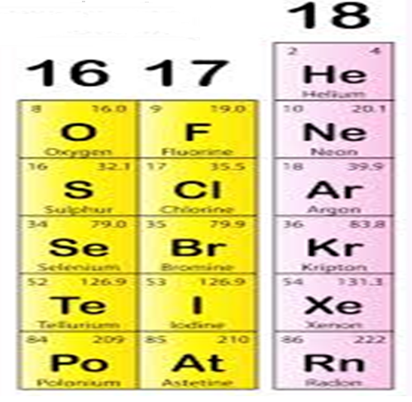
P-BLOCK ELEMENTS

Slide 2
OCCURRENCE OF 16 TH GROUP ELEMENTS
Oxygen is the most plenteous element that is accessible in nature. It shapes 20.946% of air by volume and 46.6% of the world's mass generally as silicates and different compounds like carbonates, oxides, and sulfates.
The vast majority of the oxygen in the air is delivered by photosynthesis in plants. It additionally occurs as ozone.
Sulfur is the sixteenth most inexhaustible element. Sulfur in its combined state is found in ores. Sulphate Ores: Includes gypsum, Epsom salt MgSO₄ 7H₂O,CaSO_{4.}2H₂O, and barytes, BaSO₄. Sulphide Ores: Includesgalena (PbS),zinc blende (ZnS), and copper pyrites (CuFeS₂). Sulphur can also be seen in many organic substances like mustard,eggs,seeds, onion, wool,garlic, and hair.
Selenium and tellurium are found in sulphides ores as metal selenides and tellurides.
Polonium is a radioactive element.

Slide 3
ELECTRONIC CONFIGURATION

Slide 4
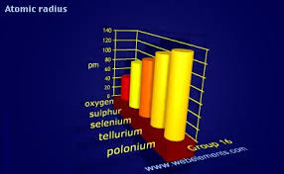
SIZE OF THE ATOM

Slide 5
GROUP 16

Slide 7
Electron Gain Enthalpy
The electron gain enthalpy decreases with increase in size of the central atom moving down the group. Oxygen molecule has a less negative electron gain enthalpy than sulfur. This is on the grounds that, oxygen, because of its compressed nature encounter more repulsion between the electrons effectively present and the approaching electron. Because of these electron-electron repulsions, oxygen particle has lesser inclination than sulfur atom to acknowledge the additional electron.
Electro negativity
There is a progressive decline in electro negativity as we move down the group from oxygen to polonium due to increase in nuclear size. After fluorine, oxygen is the second most electronegative molecule.

Slide 8
Physical Properties of the Group 16 Elements
‘Oxygen' and "sulfur" are non-metals,
"selenium" and "tellurium" are metalloids
and "polonium" is a metal under typical conditions.
Polonium is a radio-active element. Allotropy
Each one of the element of group 16 display allotropy.
Oxygen has two allotropes:
Oxygen
Ozone

Slide 9
The Melting and Boiling Points
As the atomic size increases from
oxygen to tellurium, the melting and
boiling points also increase. The huge distinction between the melting and boiling points of oxygen and
Sulfur might be clarified on the premise that oxygen exists as a diatomic atom while sulfur exits as polyatomic molecule

Slide 10
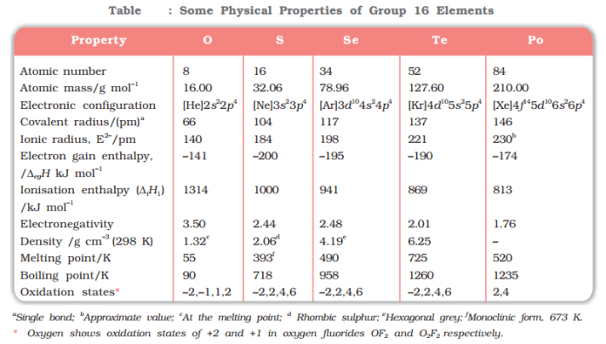
16TH GROUP ELEMENTS

Slide 11
CHEMICAL PROPERTIES OF 16 TH GROUP
Oxidation States
The group 16 elements have a configuration of ns² np⁴ in their outer shell, they may accomplish noble gas configuration either by the gain of two electrons, framing M⁻², or by sharing two electrons, in this manner shaping two covalent bonds. Thus, these elements indicate both negative and positive oxidation states. The regular oxidation states showed by the elements of group 16 incorporate -2, +2, +4, and + 6.

Slide 13
OXIDATION STATE OF OXYGEN
Oxygen shows high electro negativity. In all its metal oxides oxygen demonstrates a negative oxidation state of - 2. Despite - 2 oxidation states, oxygen illustrates - 1 oxidation state in peroxides and - 1/2 oxidation state in superoxides.
Oxygen shows positive oxidation state just in its compounds with fluorine, since fluorine is more electro-negative than oxygen. It shows +2 oxidation state in OF₂ and +1 in O₂F₂.
Remaining elements of the group, besides showing +2 oxidation states, also indicate +4 and +6 oxidation states due to the availability of d-orbitals in their particles.
Oxygen differs widely from the remaining elements of its group. This is because of its compact size, high electronegativity and the nonattendance of d-orbitals in the valence shell.

